Slide 1
Sky Islands Species Model
Create a sky islands model
Determine species preferences
Based on elevation, temperature, precipitation, and vegetation
Develop an Individual-Based Model for different species within the Madrean Archipelago
Eric Gibson

Slide 2
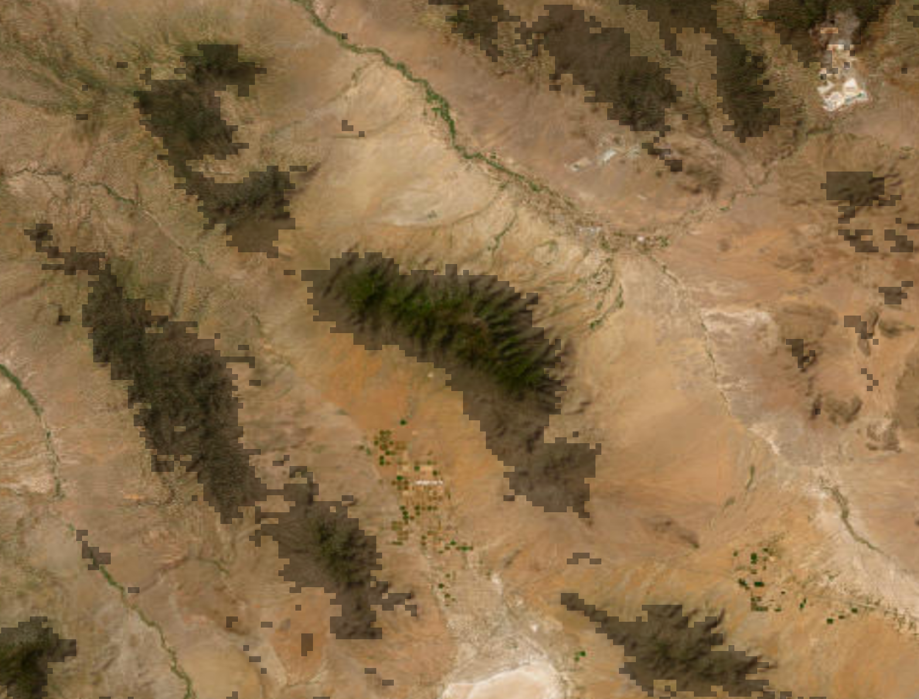
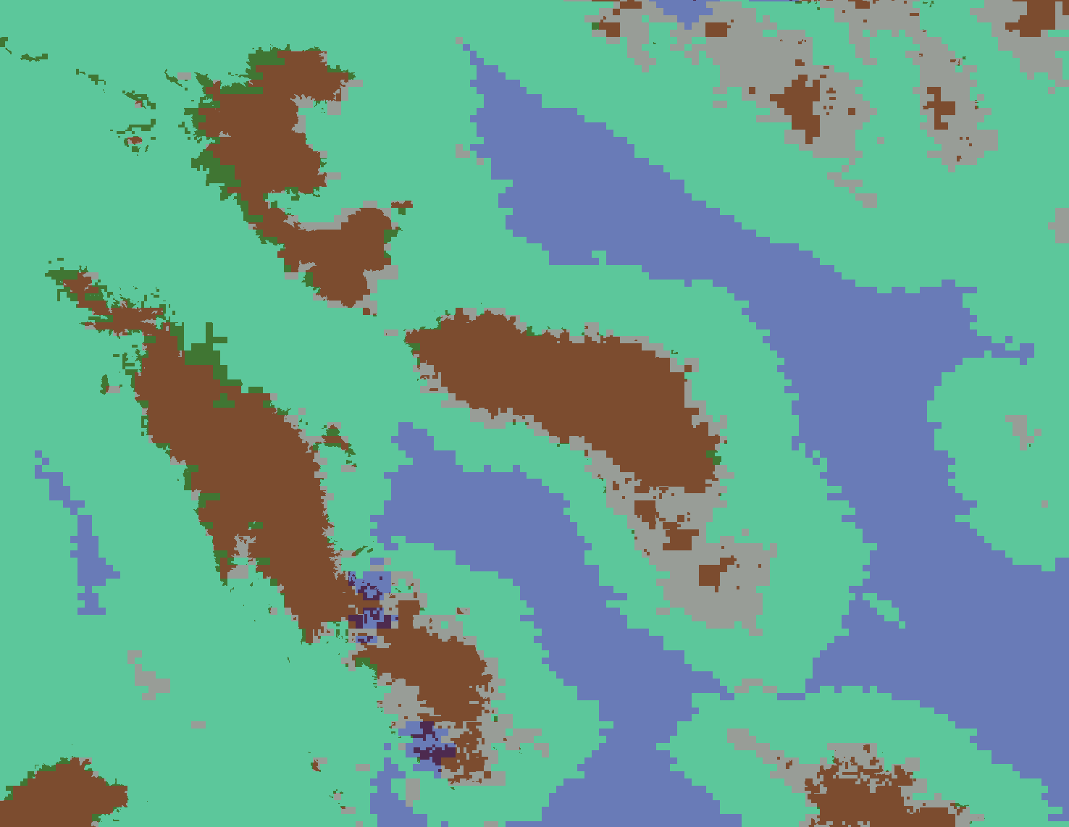
Creating Sky Islands Model

Slide 3
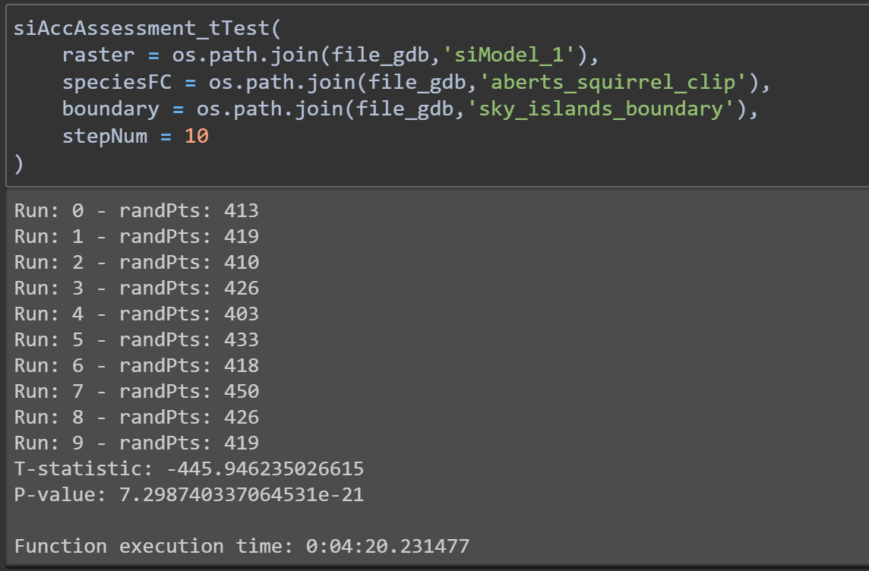
Model 1: Sky Islands
Model Description
Elevation >= 1500 meters asl
NDVI >= 5000
Precipitation >= 500 ml/yr
Temperature >= 12.5 Celsius
Validation Data Description
T-test and p-value based on species point data and randomly generated points with the same set size
Model Diagnostics - Abert’s Squirrel
Total number of points: 2647
T-statistic = -445.95

Slide 4
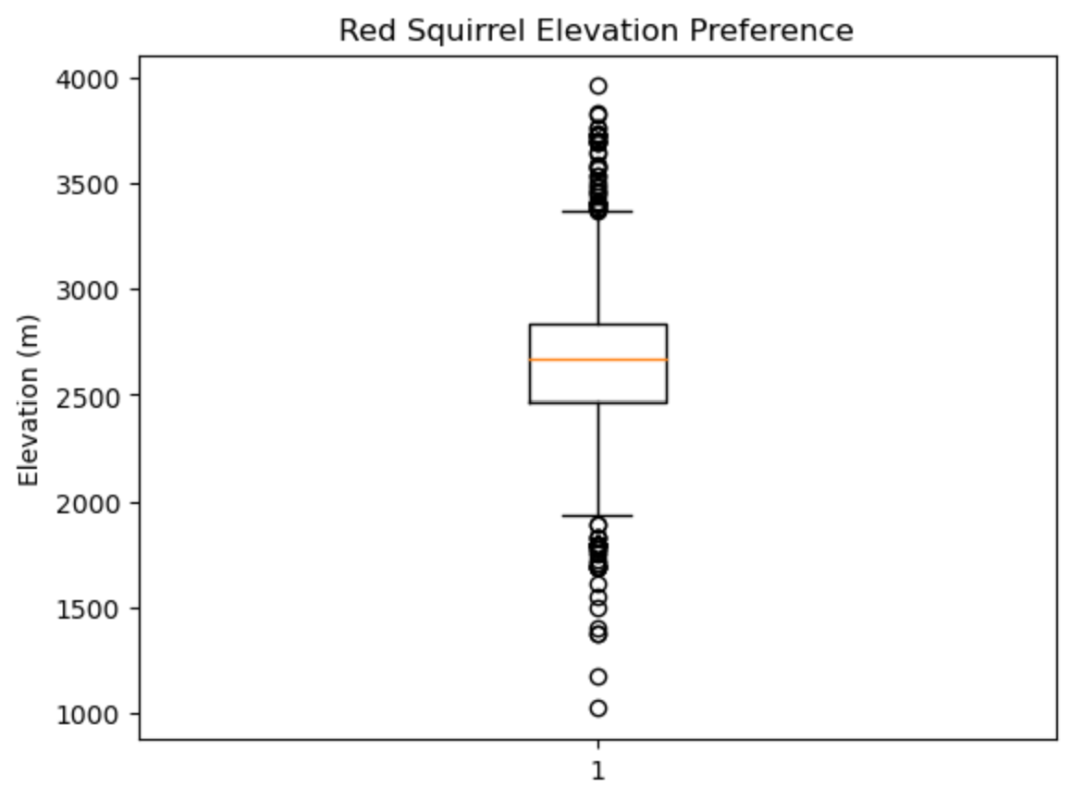
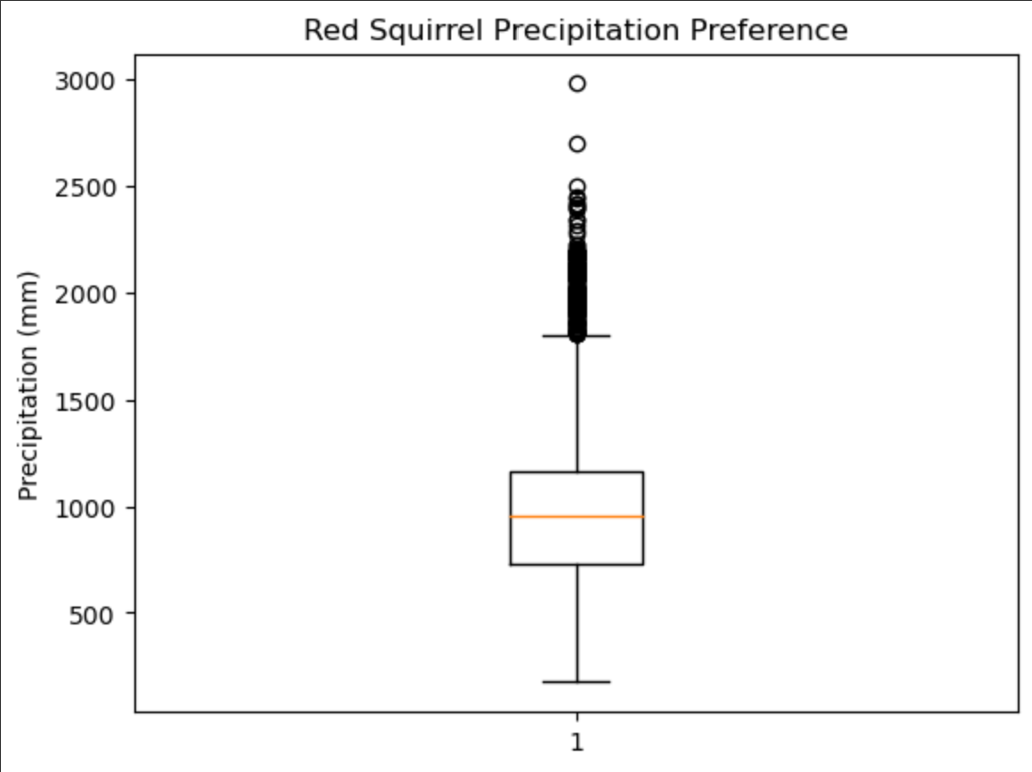
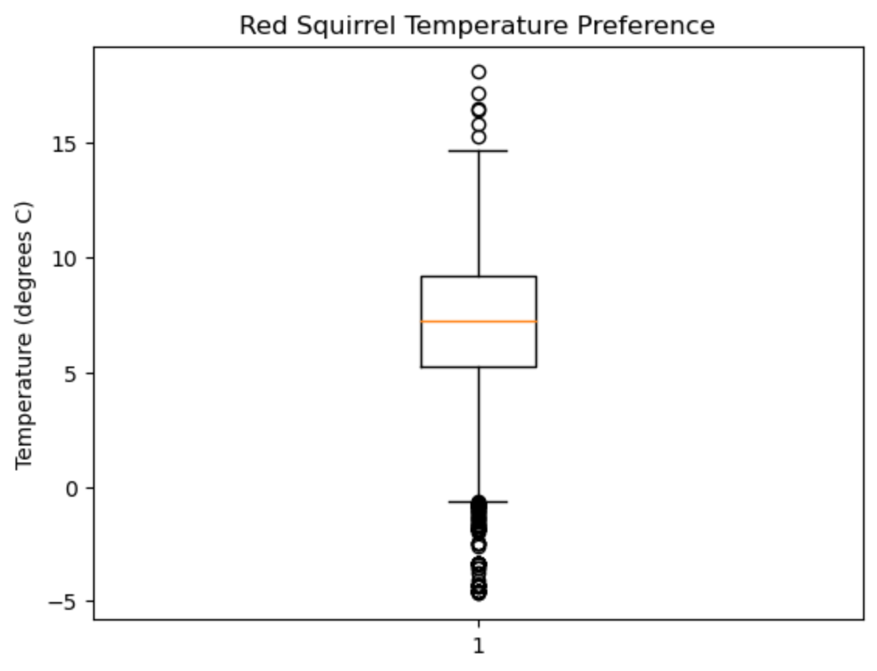
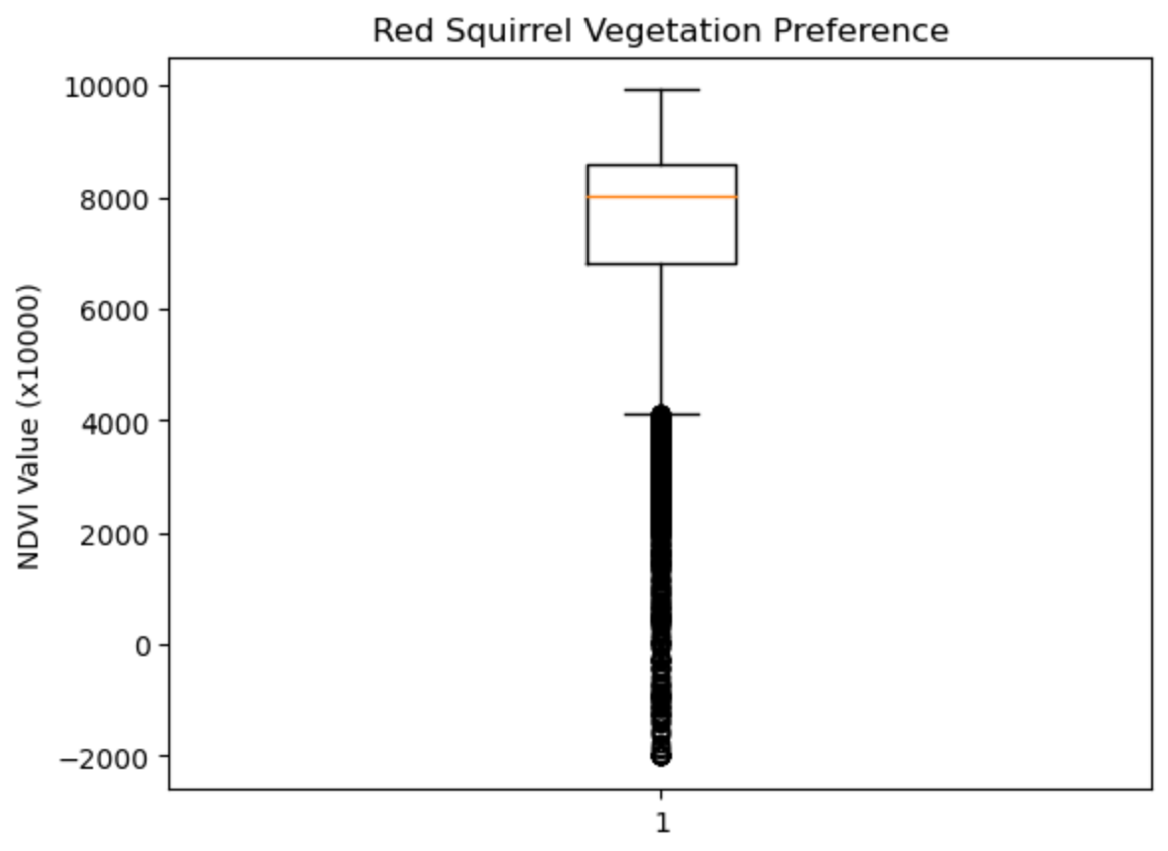
Species Preferences - Red Squirrel
‹#›

Slide 5
Steps Forward
Develop an Individual-Based Model based on the previously mentioned environmental factors
Develop a model determining changes in the sky islands region over time due to climate change
Monitor changes of individuals of the species throughout the Madrean Archipelago

Slide 6


